Slide 1
Dental Safety

Slide 2
Chain of infection

Slide 3
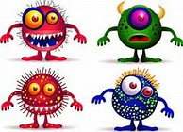
Infectious agent
A pathogen must be present in sufficient numbers to cause infection. The organism must be virulent(strength of the organism).

Slide 4
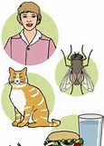
Reservoir
A place where microorganisms normally live and reproduce. Ex. Humans, food, water, animals and BIOBURDEN( organic materials such as blood and saliva).

Slide 5
Portal of Exit

Slide 6
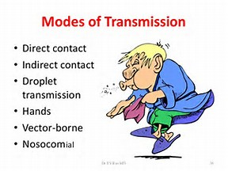
Mode of Transmission
How the infection will be carried to the new host

Slide 7
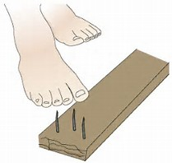
Portal of entry
A means of entering the body. That can be the mouth, nose, break in the skin by a needle stick, a cut, or even a bite.

Slide 8
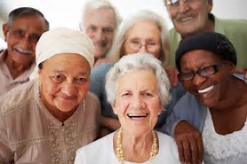
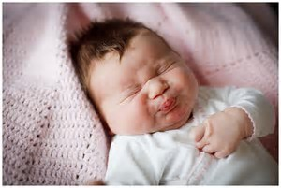
Susceptible Host
A person who is unable to resist infection by a particular pathogen.

Slide 9
Types of infection
Acute- symptoms are severe and appear soon after the initial infection. Short duration.
Chronic- microorganism is present for a long duration, maybe life. May be asymptomatic.
Latent- persistent infection where symptoms come and go. (Cold Sores)

Slide 10
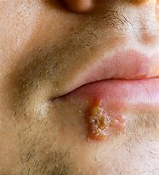

Slide 11
Modes of disease transmission
Infectious disease- one that is communicable or contagious( spread from one host to the next)

Slide 12
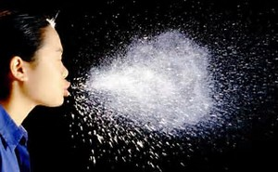
Direct transmission
Person to person contact- droplets from sneezing or coughing, unprotected contact with an infection.

Slide 13
Indirect trans.
When microorganisms first are transmitted to an object , then someone touches that object or surface.

Slide 14
Airborne Trans.
AKA droplet infection- spread of disease through droplets of moisture that contain bacteria or viruses.

Slide 15
Aerosol, Spray, Spatter(size of the droplet)
Can contain blood, saliva, and nasopharyngeal secretions

Slide 16
Parenteral
Through the skin, as with cuts or punctures.

Slide 17
Bloodborne Transmission
Through direct and indirect contact with blood and other body fluids. Especially Saliva

Slide 18
Food and Water Trans
Contaminated food or drinking water. Undercooked food or not refrigerated and or water containing human or animal fecal matter.

Slide 19
Fecal -Oral
Handwashing can prevent this.

Slide 20
Immune System
Immunity allows the body to resist disease and prevents foreign bodies from causing infection

Slide 21
Disease Transmission in the Dental Office
Patient to dental team
Dental team to patient
Patient to Patient
Dental office to community
Community to Dental Office

Slide 22
Standard and Universal Precaution
Same thing except the CDC named it Standard as a way of saying it should be the standard way of care.

Slide 23
Occupational Exposure
Table 19-1 on page 289 (Draw this chart)
The BBP standard requires all dentist/employers to offer the HBV vaccination to all employees whose jobs include category I and II tasks

Slide 24
Sharps containers

Slide 25
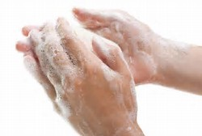
Handwashing
You must wash your hands before donning gloves and immediately after you remove them.
Pg 291

Slide 26
PPE
What are some examples?

Slide 27
What should you wear
On your paper, write something that takes place in the dental office. Then write each piece of PPE you should wear.
Ex. Processing a x-ray- Gloves, Gown

Slide 28
PPE
Protective clothing should be made of fluid resistant material. Why?
Cover as much skin as possible
Sleeves should be tucked in gloves. Why?

Slide 29
Masks
Masks should be changed after each patient or when the mask gets wet.
Remember the outside of the mask is highly contaminated

Slide 30
Eyewear
Protects eyes from aerosol pathogens and flying debris. You should have coverage on the sides as well as the front.
2 types of eyewear 1. protective side shields 2. clear face shields
Patients should be provided with eyewear. Why?

Slide 31
Latex Allergy
The primary cause of death associated with latex allergies is anaphylaxis(closure of the airway)

Slide 32
Latex sensitive pts
Vinyl/ non latex gloves and products

Slide 33
Infectious or Regulated Waste(Biohazard)
Is contaminated waste capable of transmitting an infectious disease. Never dispose in general waste

Slide 34
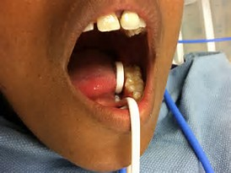
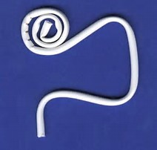
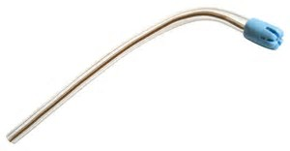
Saliva Ejectors
Backflow from low volume saliva ejectors occurs when the pressure in the patients mouth is less than that in the evacuator. This backflow can be a potential source of cross contamination between patients.

Slide 35
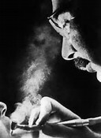
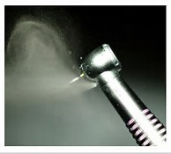
Pre procedural Mouth rinse
Rinsing with a antimicrobial rinse before a procedure. It is intended to reduce the number of organisms released during the dental procedure

Slide 36
M. tuberculosis
The microorganism that causes TB. It is spread by airborne infective particles when the patient sneezes, coughs, or even speaks. The particles can remain in the air for hours. Infection occurs when the bacteria is inhaled by a susceptible host and then travels to the lungs. This bacteria can remain alive in the lungs for years(latent TB)

Slide 37
Applying First Aid After an exposure Incident
Pg. 307

Slide 38
Handwashing before gloving
Pg.308

Slide 39
Applying Alcohol based hand rubs
Pg 309

Slide 40
Putting on/Removing PPE
Pg. 311-313

Slide 41
Disinfecting an Alginate Impression
Pg.313

